Slide 1
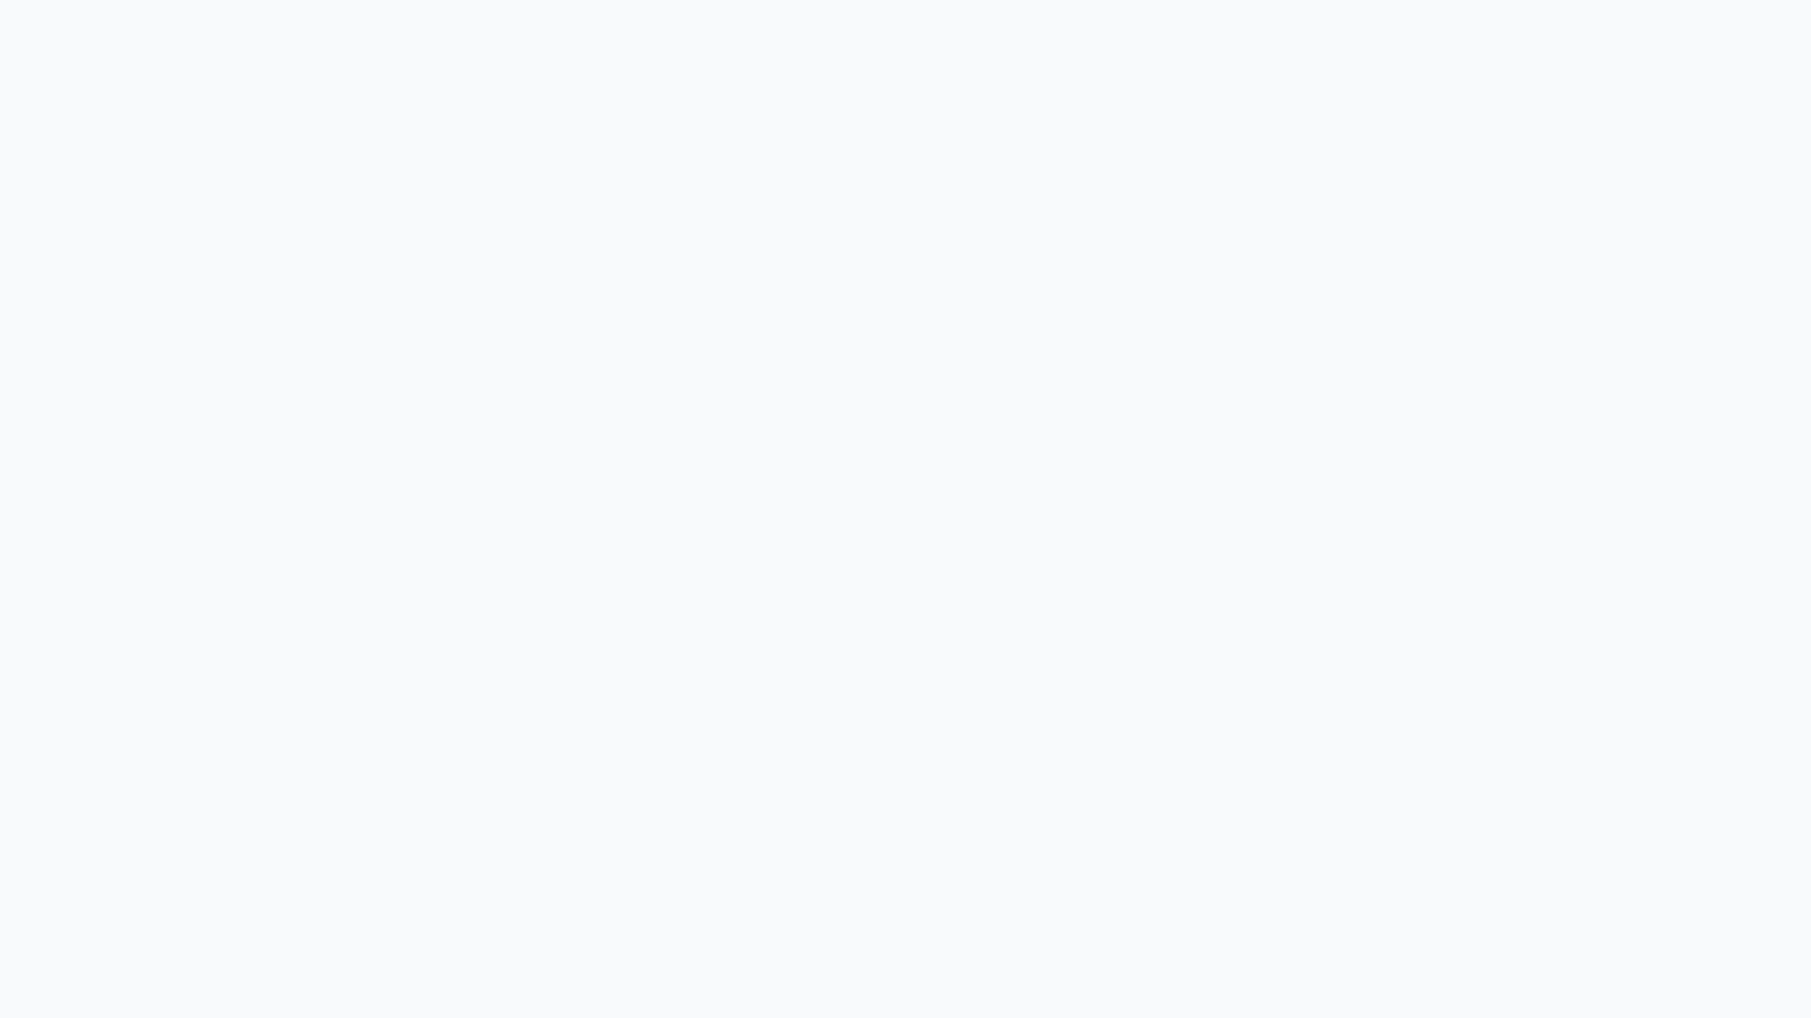



Paper ID -
Title of the Paper
Authors
4th International Conference on Artificial Intelligence, Computing Technologies, Internet of Things (IoT) and Data Analytics (AICTA 2026),
October 2-3, 2026, NIT Silchar

Slide 2
Presentation Outline
Introduction
Performance Measures
01
05
Background
Results and Analysis
02
06
Proposed Work
Conclusion and Future Scope
03
07
Dataset Description
References
04
08
4th International Conference on Artificial Intelligence, Computing Technologies, Internet of Things (IoT) and Data Analytics (AICTA 2026),
October 2-3, 2026, NIT Silchar

Slide 3
Introduction
Behavioral instances
Polymorphism
4th International Conference on Artificial Intelligence, Computing Technologies, Internet of Things (IoT) and Data Analytics (AICTA 2026),
October 2-3, 2026, NIT Silchar

Slide 4
Background
Related works [2] [3]
4th International Conference on Artificial Intelligence, Computing Technologies, Internet of Things (IoT) and Data Analytics (AICTA 2026),
October 2-3, 2026, NIT Silchar

Slide 5
Proposed Work
Language agnostic sentiment analysis ….
4th International Conference on Artificial Intelligence, Computing Technologies, Internet of Things (IoT) and Data Analytics (AICTA 2026),
October 2-3, 2026, NIT Silchar

Slide 6
Dataset Description
Language agnostic sentiment analysis ….
4th International Conference on Artificial Intelligence, Computing Technologies, Internet of Things (IoT) and Data Analytics (AICTA 2026),
October 2-3, 2026, NIT Silchar

Slide 7
Performance Measures
Accuracy = TP + TN / (TP + TN + FP + FN)
Precision = TP / TP + FP
4th International Conference on Artificial Intelligence, Computing Technologies, Internet of Things (IoT) and Data Analytics (AICTA 2026),
October 2-3, 2026, NIT Silchar

Slide 8
Results and Analysis
Proposed Method | Accuracy | Precision | Recall | F1-score
4th International Conference on Artificial Intelligence, Computing Technologies, Internet of Things (IoT) and Data Analytics (AICTA 2026),
October 2-3, 2026, NIT Silchar

Slide 9
Conclusion & Future Scope
4th International Conference on Artificial Intelligence, Computing Technologies, Internet of Things (IoT) and Data Analytics (AICTA 2026),
October 2-3, 2026, NIT Silchar

Slide 10
References
Reference 1
Reference 2
4th International Conference on Artificial Intelligence, Computing Technologies, Internet of Things (IoT) and Data Analytics (AICTA 2026),
October 2-3, 2026, NIT Silchar

